Slide 1

Data Driven Education
Discussion Forum Subteam
Presentation 3 - 04/19/2023
Notes:
Jisan

Slide 2






Team Members
Emily Cai
Data Scientist
Hyun Soo Kim
Data Scientist
Jisan Park
Project Manager
Ankit Mishra
Front-end
Web Developer
Youngwook Kang
Back-end
Developer
Rohan Karthik
Data Scientist
Notes:
All

Slide 3
Introduction
Discussion forums
  main source of interaction in MOOCs
Student interaction
  Aspect-Based Sentiment Analysis model
  Seeded Topic Modeling
Activity on forums indicative of student engagement and interest
Goal: Complete the applications of our dashboards to provide more accuracy and insights for our instructors
Notes:
Jisan
Discussion forums are the primary source of class interaction in an online asynchronous course. ABSA and Seeded topic modeling are used to increase student interaction. The activity on these forums can be used as an indicator for assessing students’ engagement and understanding in the course.
Therefore, our goals are to complete our dashboard for two courses to provide more accuracy and insights for our instructors.

Slide 4
Outcomes for Spring 2023
Category | Accomplished | Next Goals
Web Dev | Received data from Data Science team Completed two dashboards. Researched Ed Discussion API | Explore Ed discussion data Research on real-time API (REST)
UX Research | Received Interview Feedback from TA | Get more feedback based on UX
Data Science | Seeded Topic Modeling with each course data Metacognitive Presence Visualization ABSA | Increase the accuracy for each model Research new feature that help instructors
Thoughts as a Project Manager:
Having team’s own deliverables every week made the team more engaged.
Communication among team members is important.
Building weekly sprint for next month stays team member focused.
Notes:
Jisan
This semester we focused on deploying all the data for our dashboard which should help instructors get insights on class participation, forum activity, instructor involvement etc. The data science team delivered the results for Topic Modeling and ABSA as well as the organized data for the dashboard. Based on the interview feedback, we decided to make some changes on dashboard. Data science team will research new actionable feature that help instructors. Web-dev team received all the data from data science team, so we have filled dashboard with the data we have. Since there is a new uprising discussion forum which is Ed discussion, web-dev team researched on the API, and they will explore further how to obtain the data.
As a project manager for a short time, I learned a lot of new things. firstly, having team’s own deliverables made the team members more engaged. I also found that I need more communication skills to make team feel more comfortable and I noticed that creating an environment that promotes communication between team members was also PM’s job. Finally, creating 4 weekly sprints every month is very helpful in improving team member’s focus and engagement.
Now, I’d like to hand over to Data science team.

Slide 5
Data Science

Slide 6

Review of Research Questions
Based on the community of inquiry framework, what are some useful metrics for student engagement and performance in an asynchronous online classroom?
  how can we use the user feedback from last semester and expand our research to understand specific applications for the models we are developing?
  how can we improve upon the accuracy of the models we've already developed without quantified indications?
How can we design a web app that can provide actionable insights to the instructor?
  how can we make the web app user-friendly and compatible with different devices?
Notes:
Emily
Here is a reminder of the research questions we focused on this semester
To summarize, we wanted to find useful metrics for student engagement/performance through online discussion forums, expand our research from last semester's feedback, improve our accuracy on past models, and make an effective and user-friendly web dashboard that provided helpful insights to the instructors
we will answer/address each of these questions throughout the presentation
- fortunately, we've been making progress toward answering each question
paraphrase question. Through our use of different data science methodologies (discussed in next slide), we are analyzing various data to formulate potential metrics and answers for measuring/improving student engagement
paraphrase question (we've been expanding our research by for example exploring different types of topic modeling and seeing which one provides more promising and reliable models for instructors to use, and we will continue to expand our research
paraphrase question (we cannot actually base our accuracy of the models off of percentages or statistics, so we are trying our best to improve accuracy of these models based on their relevance/importance and I'll talk about that later)
two dashboards are still in the process of being created (will be shown in later slides), and the data science team will try their best to provide the web-dev team with useful insights from our created models/data results.
while the dashboards are being finalized we will focus on how to make the dashboards user-friendly and compatible with various devices

Slide 7
Data Science Updated Big Picture
Analyzing CS1301 and CS6601 Discussion Forums Data
Replacing unsupervised topic modeling with guided topic modeling -> increased accuracy determined by more relevant topics outputted by models
Connecting student sentiment/attitude in education with ABSA
Visualizing the effect of metacognitive presence in a classroom
Cognitive Presence
Metacognitive Presence
Data Science
Topic Modeling
Aspect-Based Sentiment Analysis
Notes:
Emily
From our CS 1301 (Intro to Programming) and CS6601 (AI) data from ed and piazza, we are using Topic Modeling and ABSA to output data that we can analyze. With this data, we are trying to pinpoint indications of student engagement to provide useful data to instructors in the dashboards
Last semester, the data science subteam utilized unsupervised topic modeling (issues with accuracy), and this semester we've decided to replace this with guided topic modeling. The accuracy seems to have already increased with our models, which are outputting more relevant topics from the discussion forums
topic modeling (scans a set of documents and clusters word groups and similar expressions together to pinpoint what students are mainly discussing)
Though we are focusing on topic modeling right now, we are still interested in using Aspect-based sentiment analysis (ABSA) to examine student sentiment towards certain aspects in education
In terms of metacognitive data, we are focusing on visualizing the effects of this presence in a classroom setting, and this will be elaborated on later in the presentation

Slide 8
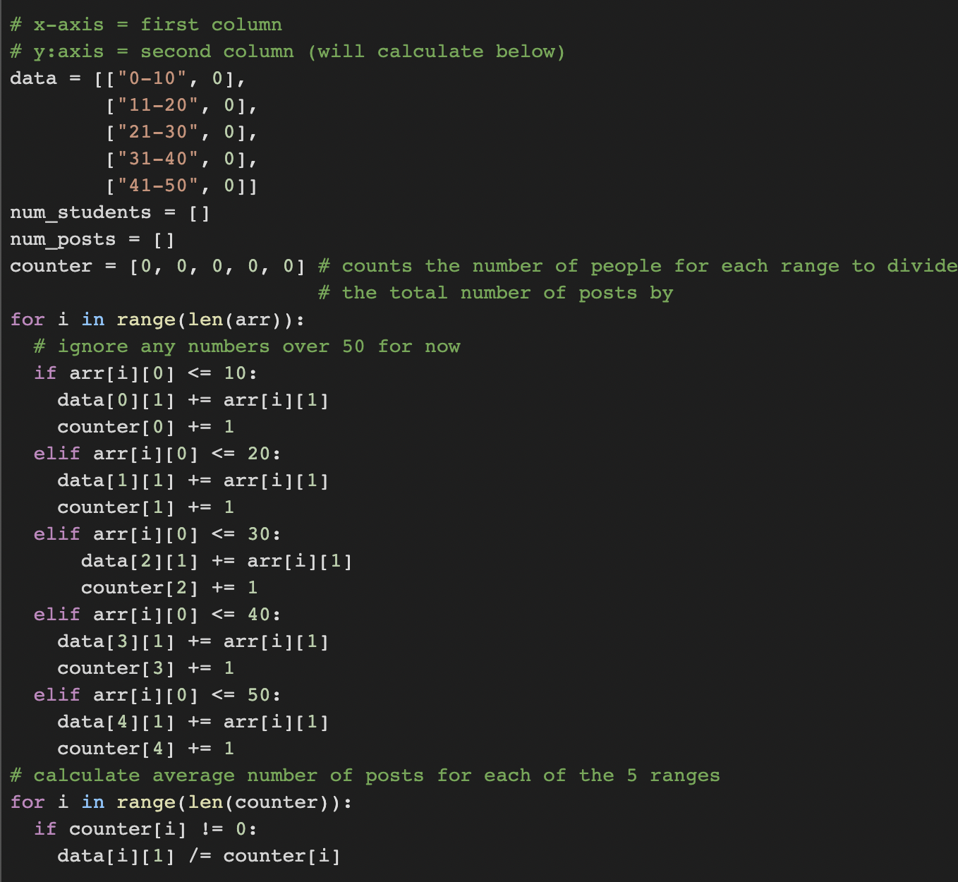
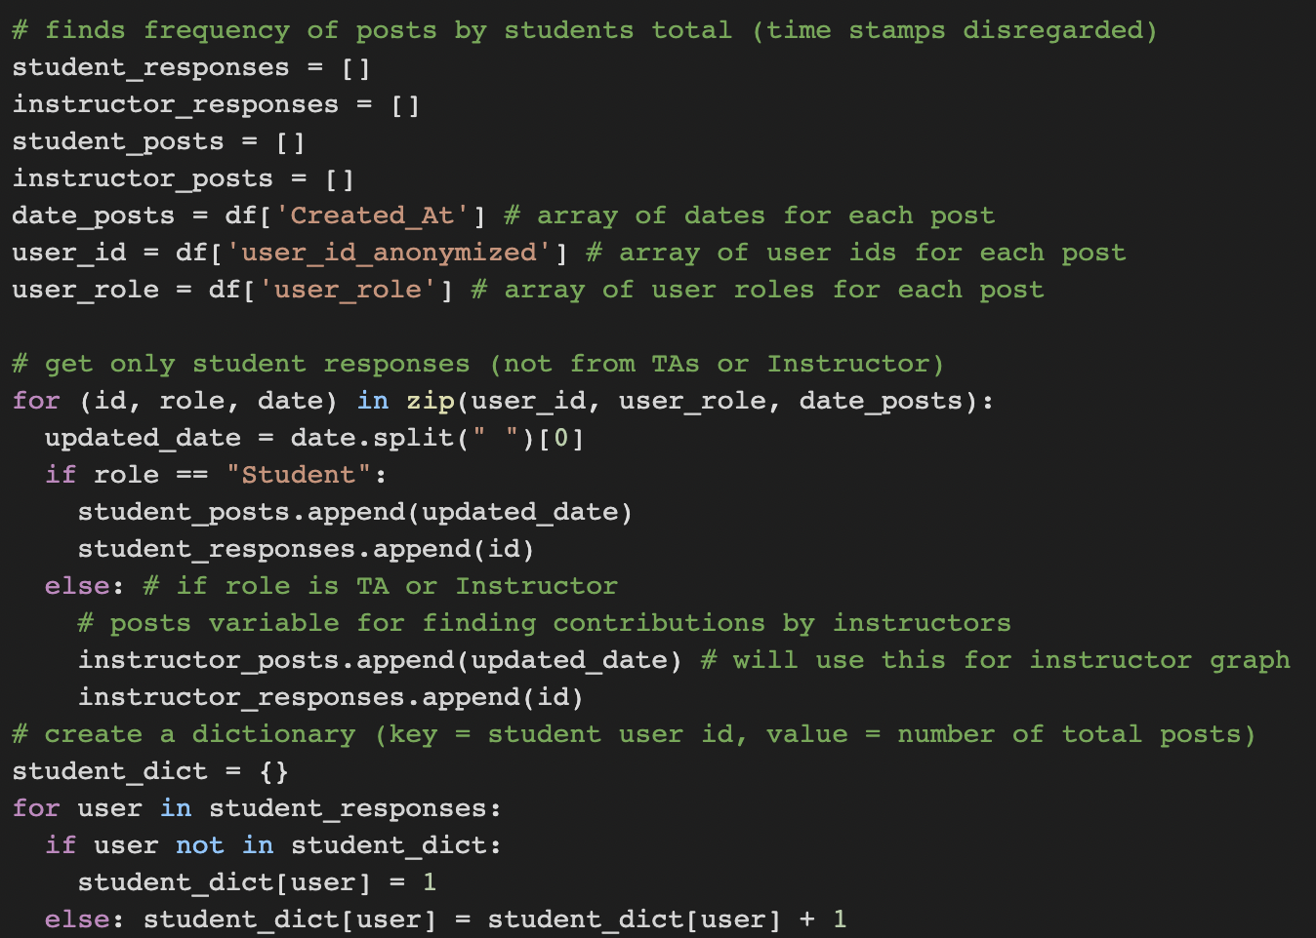
Results from Real-Time Piazza/EdX Data
CS 1301 and CS 6601:
Calculated and visualized:
  average frequency/number of posts by students
  average frequency/number of posts by instructors, but 1301 data did not give sufficient information (seen in next slide)
CS 6601:
Also visualized:
  the frequency of posts by students every 4-5 days
  the frequency of posts by instructors every 4-5 days
Separated student and instructor responses to visualize graphs for each user type
Notes:
Emily
For both cs 1301 and cs 6601, I was able to calculate and visualize the average frequency of posts by both students and instructors separately, but the 1301 data did not give as much sufficient information as cs 6601, which i will elaborate on in the next slide
for 1301 specifically, there was a data point that was over 100 values away from the rest of the data, (200+, 1), so I adjusted the code to make the maximum x-value 50 as seen on the right-> but it makes sense why the coordinate pair exists (over 200 students posted exactly once) -> this is definitely something to consider for next semester
the code on the bottom right shows how I was able to distinguish instructor responses from student responses
Since the cs 6601 data had more information, I was also able to visualize the frequency of posts by students as well as instructors overtime every few days using line graphs, which will be seen in a later slide

Slide 9
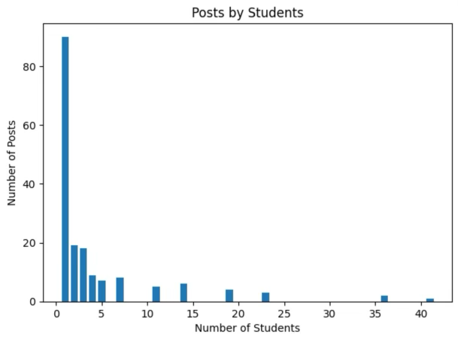
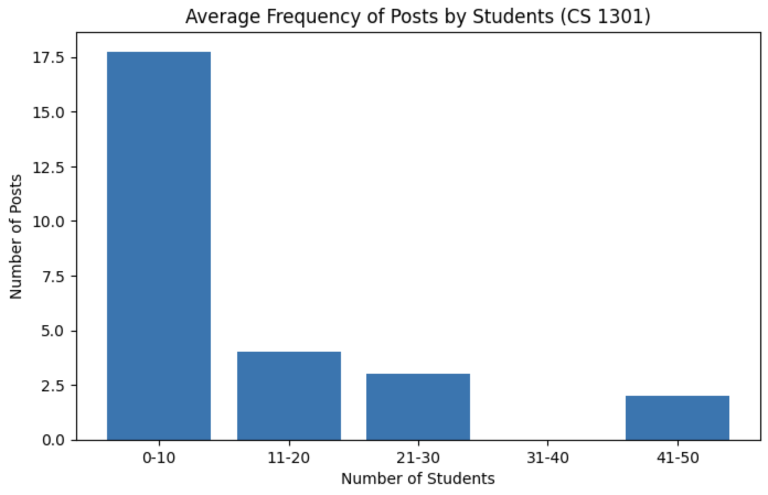
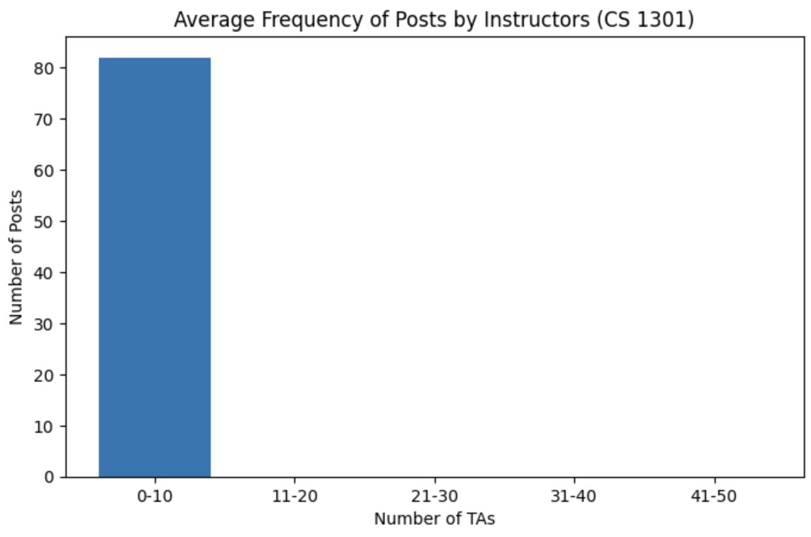
Graphs Displaying Data (CS 1301)
More readable/organized for instructors
"There were between 0 and 10 students that have posted 17.5 times on average"
"There were between 11 and 20 students that have posted 4 times on average"
"1 student posted 94 times"
"41 students posted 1 time"
*outlier (200+, 1) not shown in either graph*
Drawbacks of CS1301 Data:
The date/time stamp of each post was not given, so could not calculate number of posts over time
Each TA had the same user ID and title ("Community TA") -> impossible to distinguish between distinct TAs
From the data only one unique Instructor, one unique Community TA -> number of total instructor posts was divided by 2 (not accurate)
Notes:
Emily
So here are the graphs I created from the 1301 data. The graph on the left basically displays how many students posted however many times. For example, *I read bullets*
I made the graph more organized by grouping the x-axis into intervals of size 10 for now and I simply averaged all of their responses within each interval
as said before, the 1301 data did not have as much information compared to 6601. *read bullets* total of 164 instructor responses, which explains why it's 82 on the graph
therefore, the graph on the bottom left does not provide insightful or even accurate information due to the data's lack of time stamps and unique user ids, so we will keep this in mind for the future and see if we can create more effective graphs with limited data

Slide 10
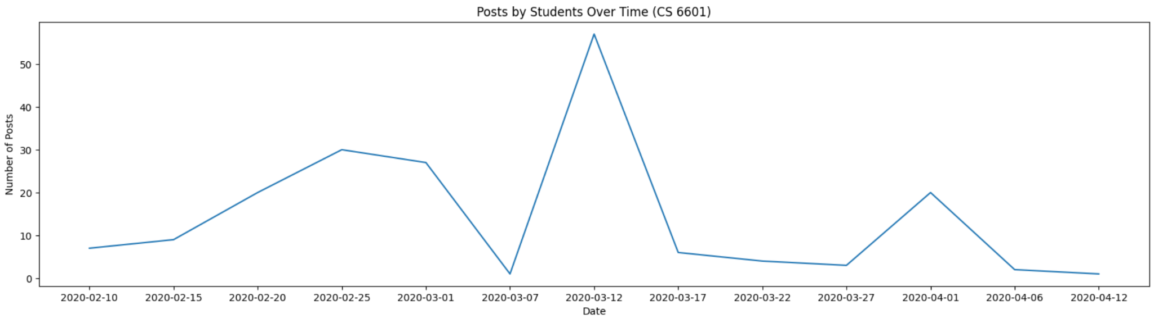
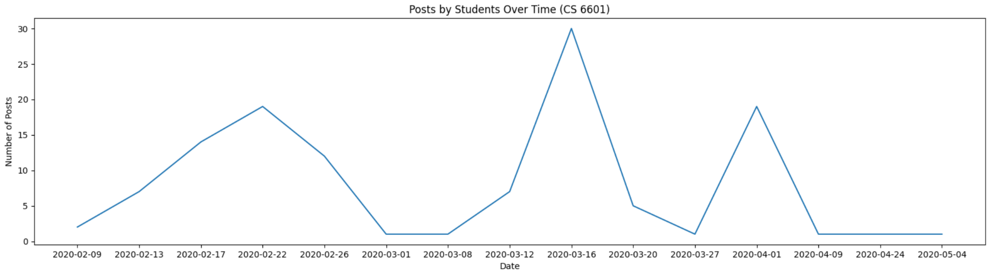
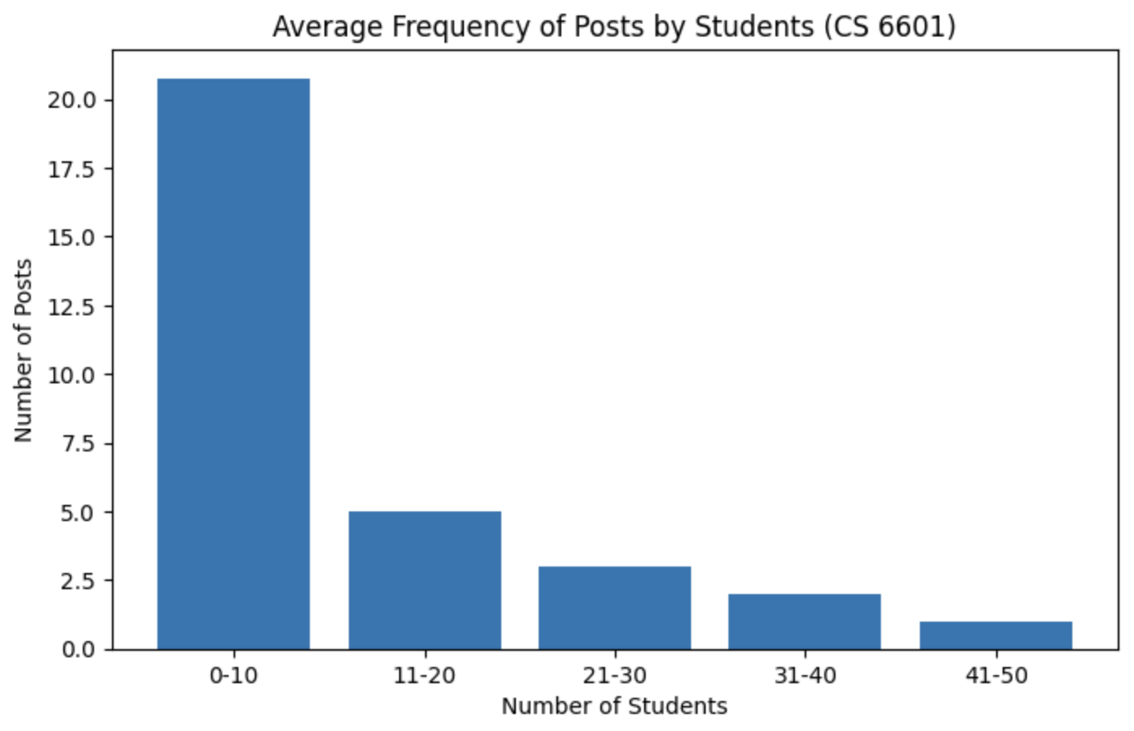
Graphs Displaying Data (CS 6601)
Number of posts increased during midterm/exam weeks from both Students and Instructors
First two peak dates, the instructors posted about half as much as the students total
Number of posts by Instructors depend on those of the students -> students post more, instructors respond more
displays very similar trend compared to the same graph for 1301
less than or equal to 10 students posted frequently (20x on average), while over 41 students posted about once on average
only a select few are frequently involved/engaged in the online discussion forums
Notes:
Emily
For cs 6601, I was able to create line graphs, displaying the number of posts by students every 4-5 days, and compared it the same graph but for instructors
insights: seems as though there is more student and instructor engagement during midterm weeks, as shown by the 3 peaks. The shapes of the graphs are very similar, showing that instructors respond more when students ask more questions -> makes sense
however, instructors posted less than students on average (as seen by y-axis values 30 vs 50), so the instructors, including the TAs, could make this insight and try to be more active in discussion forums to improve the experience for the students (more likely to use it in the future)
If the trends were different however, such as instructors responses didn't peak at the same time as student responses, this would ALSO allow the instructor to maybe take action and ensure that the TAs are prepared for these predictable peaks for when students post
the graph on the bottom left displays a similar trend as the same graph for 1301 *read only last bullet*

Slide 11
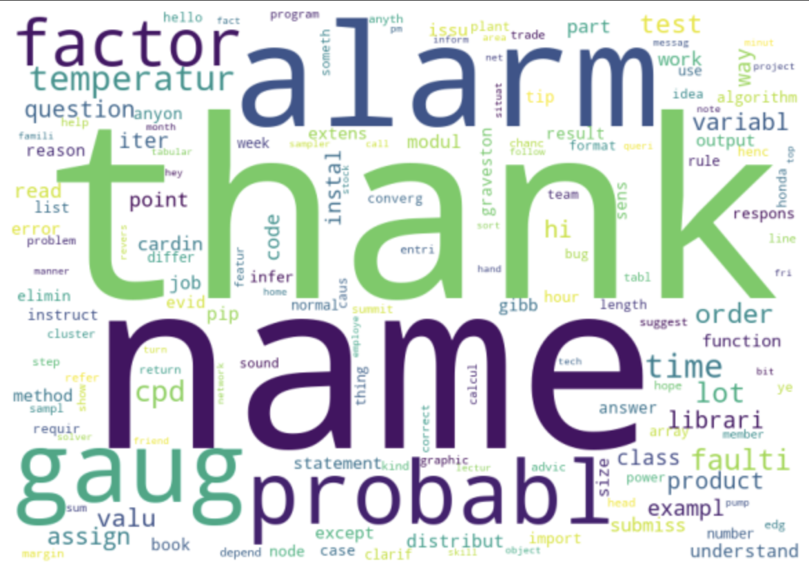
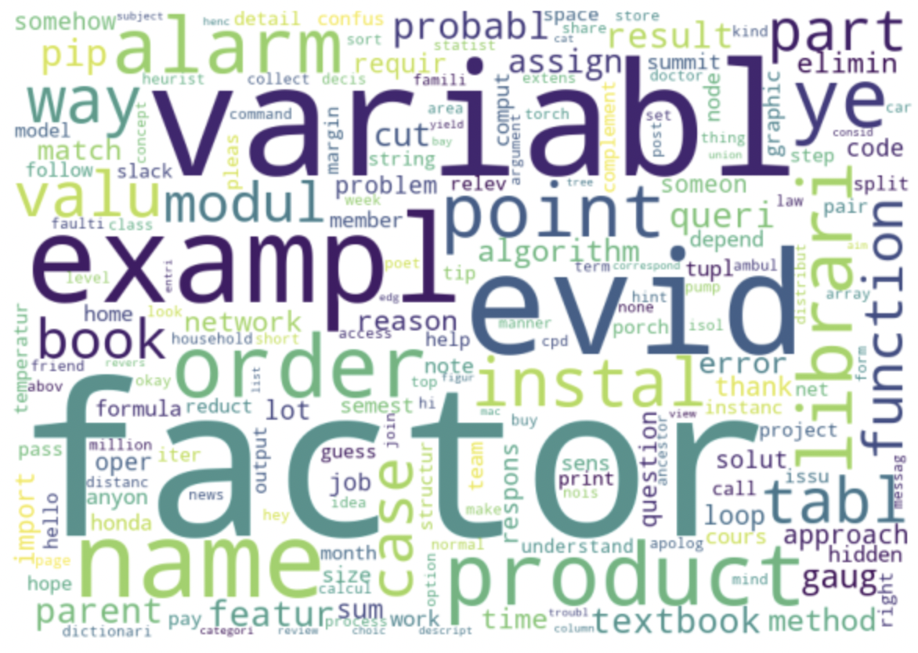
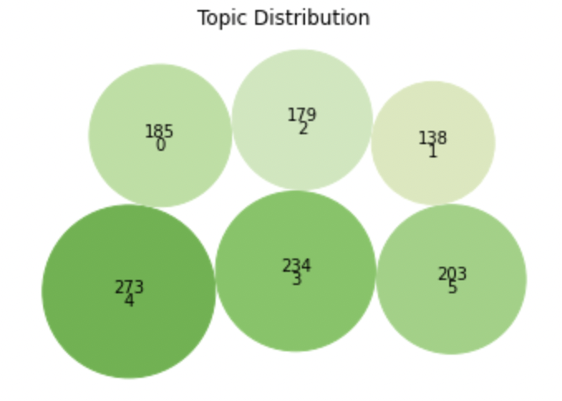
Topic Modeling
Topic Modeling - unsupervised
  scan documents, detect words, cluster groups
  should be aware of dominant topic
  limitation: the top topic was irrelevant to the course contents
Visualization on Piazza data
Notes:
Harriet
Topic Modeling is unsupervised ML technique that can scan a set of documents, detect words and phrase patterns within document, cluster word groups, and classify document by topic. We expected that Teaching team is aware of what students mainly talk about and what question comes frequently in the discussion forum. But, we faced the limitation that is the top topic has too wide range and general words. We made a bubble chart to see topic distribution by documents, 273 documents has topic 4 which has a left word cloud. Those two word clouds for the top two topics are irrelevant to the course contents. So we think of it needs labels to guide the model.

Slide 12
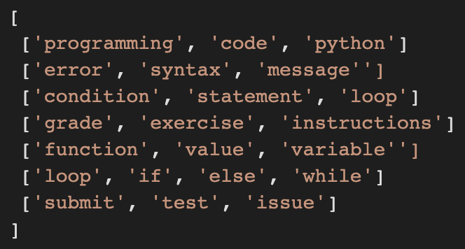
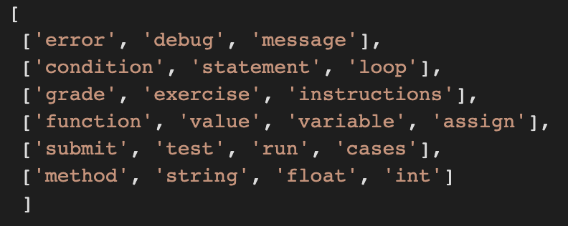
Guided Topic Modeling
Topic Modeling with predefined seeded topics
  Set several seeded topics to which the model will converge towards (assuming the seeded topics are accurate/relevant)
  Provided seeded words for each topic, so each word is related to a specific topic/content
  Recognized the accuracy/specificity of each seeded topic was important -> made topic lists less vague and more narrowed; added potential stop words such as "if", "you", "him", and "thank":
Expectations/Plans:
  Continually try to improve the accuracy of classification by topic through already reliable methods
  Experiment with code and discover more potential methods to increase relevance/accuracy
Before
After
Notes:
Emily
guided (aka seeded) topic modeling
(read first bullet) seeded topics essentially "train" or "guide" our model as an attempt to output more accurate/relevant topics from the discussion forum responses that we were given from the two courses
Seeded topic models pass a collection of keywords to the model, outlining the sought out themes before the estimation
as you can see below, the seeded topic lists are 2-d arrays, where each row is composed of words closely associated with one another, whether they were mentioned in the same discussion forum post, or they had relatively similar meaning
however, once we ran our model with the topic list on the left, the model outputted topics seemingly irrelevant to the course content and didn't help us with potentially indicating student engagement, so we improved this by making our seeded topic list more narrow and adding more stop words such as "if","you","him", and "hello" (stop words are terms we want our model to disregard since they are unimportant words in discussion posts)
"programming" and "code" too vague
as a result, our model began outputting more meaningful and thus more accurate results!
expectations and plans for the rest of the semester (read them)
such as looking at model output, adding more stop words based on the output, discussing with other team members on their approaches that have worked
brainstorm other ideas for improving accuracy, experiment with code by making small changes and seeing how the model's output also changes; gathered that small changes are better than major ones so we know what changes caused what results in order to maximize accuracy

Slide 13
Guided Topic Modeling
<Original>
Yeah.. You would need to use the string methods to see if the strings are ints or floats. You can't use int() or float(). There was a link to useful methods in the lesson, which I'll link here: https://docs.python.org/3.7/library/stdtypes.html#string-methods
Improvement
  Higher Accuracy with more preprocessing
    Narrowed seeded topics down
    Removed tense features(integrating past/present/future tenses)
    Removed URL/email/punctuation, Integrated upper/lower cases
    Deleted irrelevant words by setting them manually
  Instructors can match each post with a specific topic from the topic list
  Generated .json file
Challenges
  Calculate coherence score to see actual improvement
<Preprocessed>
yeah need use string method string int float not use int float link useful method lesson ill link here
<Topic>
['float', 'int', 'string', 'error', 'integer', 'round', 'sort']
Notes:
Harriet
The data science team also implemented 2 models, guided topic modeling and aspect based sentiment analysis. Since we covered the result for the guided topic modeling in the last presentation, I will
pass this slide and just say that we could get the result with high accuracy by applying a lot of pre-processing to this model.
The data science team also implemented 2 models, guided topic modeling and aspect based sentiment analysis. Since we covered the result for the guided topic modeling in the last presentation, I will go over this slide really fast. We used general topic modeling model last semester, and we switched the model into guided topic modeling which takes in the guided topics and generate the topics regarding those given topics. We added a lot of pre-processing as well, and we could get the meaningful result with higher accuracy.

Slide 14
ABSA
Switched the model to Bert-Sentiment
  Overall class sentiment
  Aspect-based sentiment for each post/comment
Improvement
  Higher Accuracy
  Applied result from topic modeling as aspects
  Applied simpler but more meaningful pre-processing
    Removed HTML tags
    Effectively removed extra spaces between words
  Modified hard-coded code into variable-based code
    Easily change aspect in the future when needed
  Generated .json file
Challenges
  Calculate F1 score to see actual improvement
<Post>
I've finished my submission for Assignment 4 and marked it active in Gradescope (should be the final one scored as 100).
OK. Right now I am only calling my fit function in my unit tests, so I'm not sure how that's going to help me when I submit to GradeScope. Should I be calling fit somewhere else?
<Result>
gradescope(+), assignment(+)
test(0), functions(0), gradescope(-)
Notes:
Harriet
Aspect-based sentiment analysis is basically performing sentiment analysis in respect to given aspects. The major change we’ve gone through is that we switched our model to Bert-Sentiment. We could get higher accuracy with this model. We generated overall class sentiment and aspect-based sentiment for each post/comment, if it is positive, neutral, or negative. We applied the result from the topic modeling process as aspects, and simplified the pre-processing step, because there were some meaningless pre-processing codes. We simply removed HTML tags from the posts so that they look more like human-written posts, and removed the extra spaces between words as well. Also, we modified the hard-coded code into variable-based code. For example, we accessed the aspect values by using fixed string of the aspects, but now we are accessing them by indexing into an aspect array. Finally, we generated .json file so that Web-dev team can easily show the result on the dashboard. One challenge is that it is hard to calculate F1 score which computes the accuracy of the model, because there is no true answer that the model should generate.
On the right side of the slide, I brought 2 examples to show you the result. And since we don't have much time, I will only introduce the second example. In the comment, it says “OK. Right now I am only calling my fit function in my unit tests, so I'm not sure how that's going to help me when I submit to GradeScope.” and our model says that the comment is neutral for the aspects “test” and ‘functions” but negative for the aspect “gradescope”. Like this, we could get pretty reasonable result for the implementation.
Aspect-based sentiment analysis is basically performing sentiment analysis in respect to given aspects. The major change we’ve gone through is that we switched our model to Bert-Sentiment. We first did so because the library that we imported for the model last semester crashed, but after switching to the new model, we figured out that it actually works better than before, so we decided to stick to it. So we generated overall class sentiment and aspect-based sentiment for each post/comment, if it is positive, neutral, or negative. We applied the result from the topic modeling process as aspects, and simplified the pre-processing step, because there were some meaningless pre-processing codes. We simply removed HTML tags from the posts so that they look more like human-written posts, and removed the extra spaces between words as well. Also, we modified the hard-coded code into variable-based code. For example, we accessed the aspect values by using fixed string of the aspects, but now we are accessing them by indexing into an aspect array. Finally, we generated .json file so that Web-dev team can easily show the result on the dashboard. One challenge is that it is hard to calculate F1 score which determines the accuracy of the model, because there is no true answer that the model should generate.
On the right side of the slide, I brought 2 examples to show you the result. The first comment says “I've finished my submission for Assignment 4 and marked it active in Gradescope (should be the final one scored as 100).” And our ABSA model generates the result that the comment is positive for both aspects “gradescope” and “assignment”. In the second example, the comment says “OK. Right now I am only calling my fit function in my unit tests, so I'm not sure how that's going to help me when I submit to GradeScope. Should I be calling fit somewhere else?” and our model generates the result that the comment is neutral for the aspects “test” and ‘functions” but negative for the aspect “gradescope”. Like this, we could get pretty reasonable result for the implementation.

Slide 15
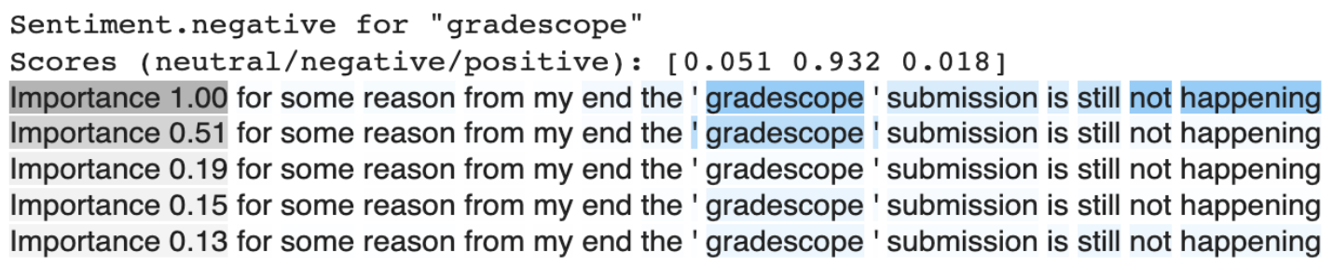
ABSA
Aspect-Based Sentiment Analysis
  Technique that categorizes text data by aspect and identifies the sentiment attributed to each one
  Can provide reasonable sentiment for aspects depending on students’ current circumstance for multiple aspects at once
Tested and trained on Piazza data
  Example input:
    Text: for some reason from my end the ' gradescope ' submission is still not happening
    Aspects: [test, project, quiz, homework, gradescope, assignment]
  Example output:
Notes:
Harriet
Last semester, we worked on Aspect-based sentiment analysis. To give you guys a brief overview, it is a Technique that categorizes text data by aspect and identifies the sentiment attributed to each one. We thought this is efficient to analyze Piazza data, because we can provide reasonable sentiment for aspects depending on students’ current circumstance for multiple aspects at once. As you see on the slide, here is an example text input and output. A student posted that “for some reason from my end the gradescope submission is still not happening.” You can see that the word “gradescope” is acting as a negative word in this text. We used 6 aspects, and for the “Gradescope” aspect, you can see that it is evaluated as “93% negative” from our model.
I will pass the slide to Jisan to talk about our work with topic modeling from the last semester.

Slide 16
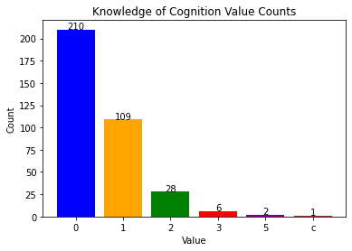
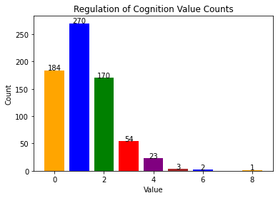
Metacognitive Presence
The visualizations will ideally show the success of the student related to their metacognitive presence within every post but…
Data for the metacognitive presence was limited so not many visualizations were possible
The dashboard utilized more active in discussion forums such as time taken between posts and total number of active posts. Metacognitive data didn’t fit well as it shows a cumulative score for all students over many different posts
Notes:
Rohan

Slide 17
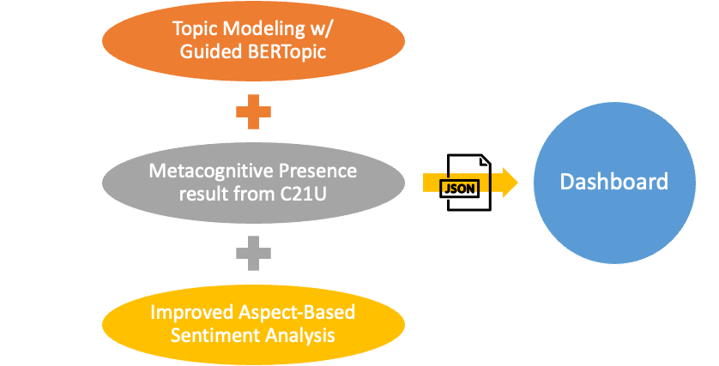
Overall Semester Goals
Notes:
Rohan
Our goal for this semester is to show our result from the data science models to our web page dashboard. So we are going to generate our result as .json file and transfer them to the Web-dev team. Currently, we are dealing with the Ed data from CS1301 class and Piazza data from CS6601 class. As we have presented today, we have been working on topic modeling with guided BERTopic. We have also worked on visualizing the metacognitive presence result we received from C21U research team. We are planning to provide more data from this, and we are on our process of brain-storming which feature we can get from the data. The last thing we are going to do is to improve accuracy of our Aspect-based sentiment analysis model from the last semester and also apply CS1301 dataset to our model.

Slide 18
Web Development

Slide 19

Notes:
Ankit

Slide 20
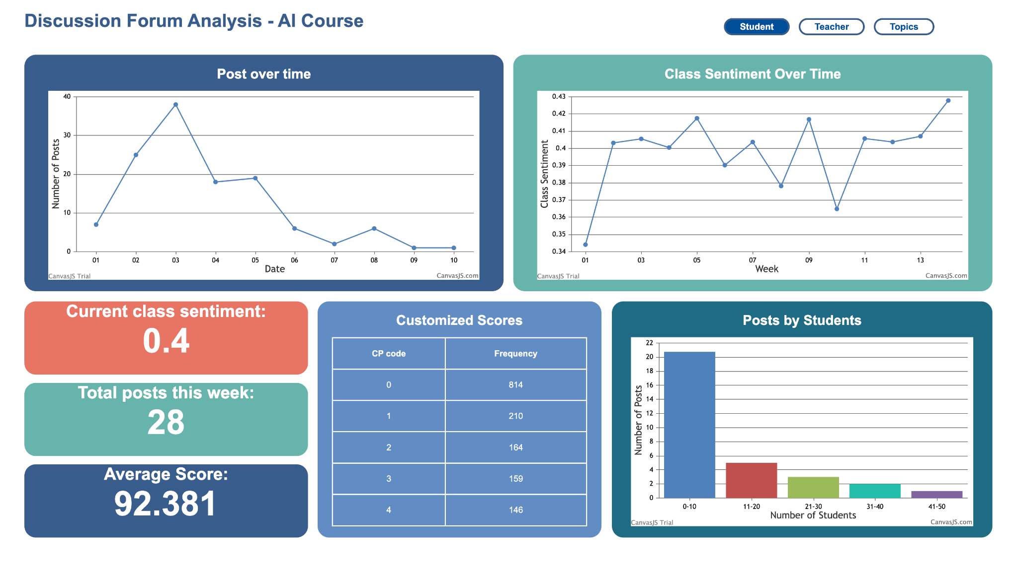
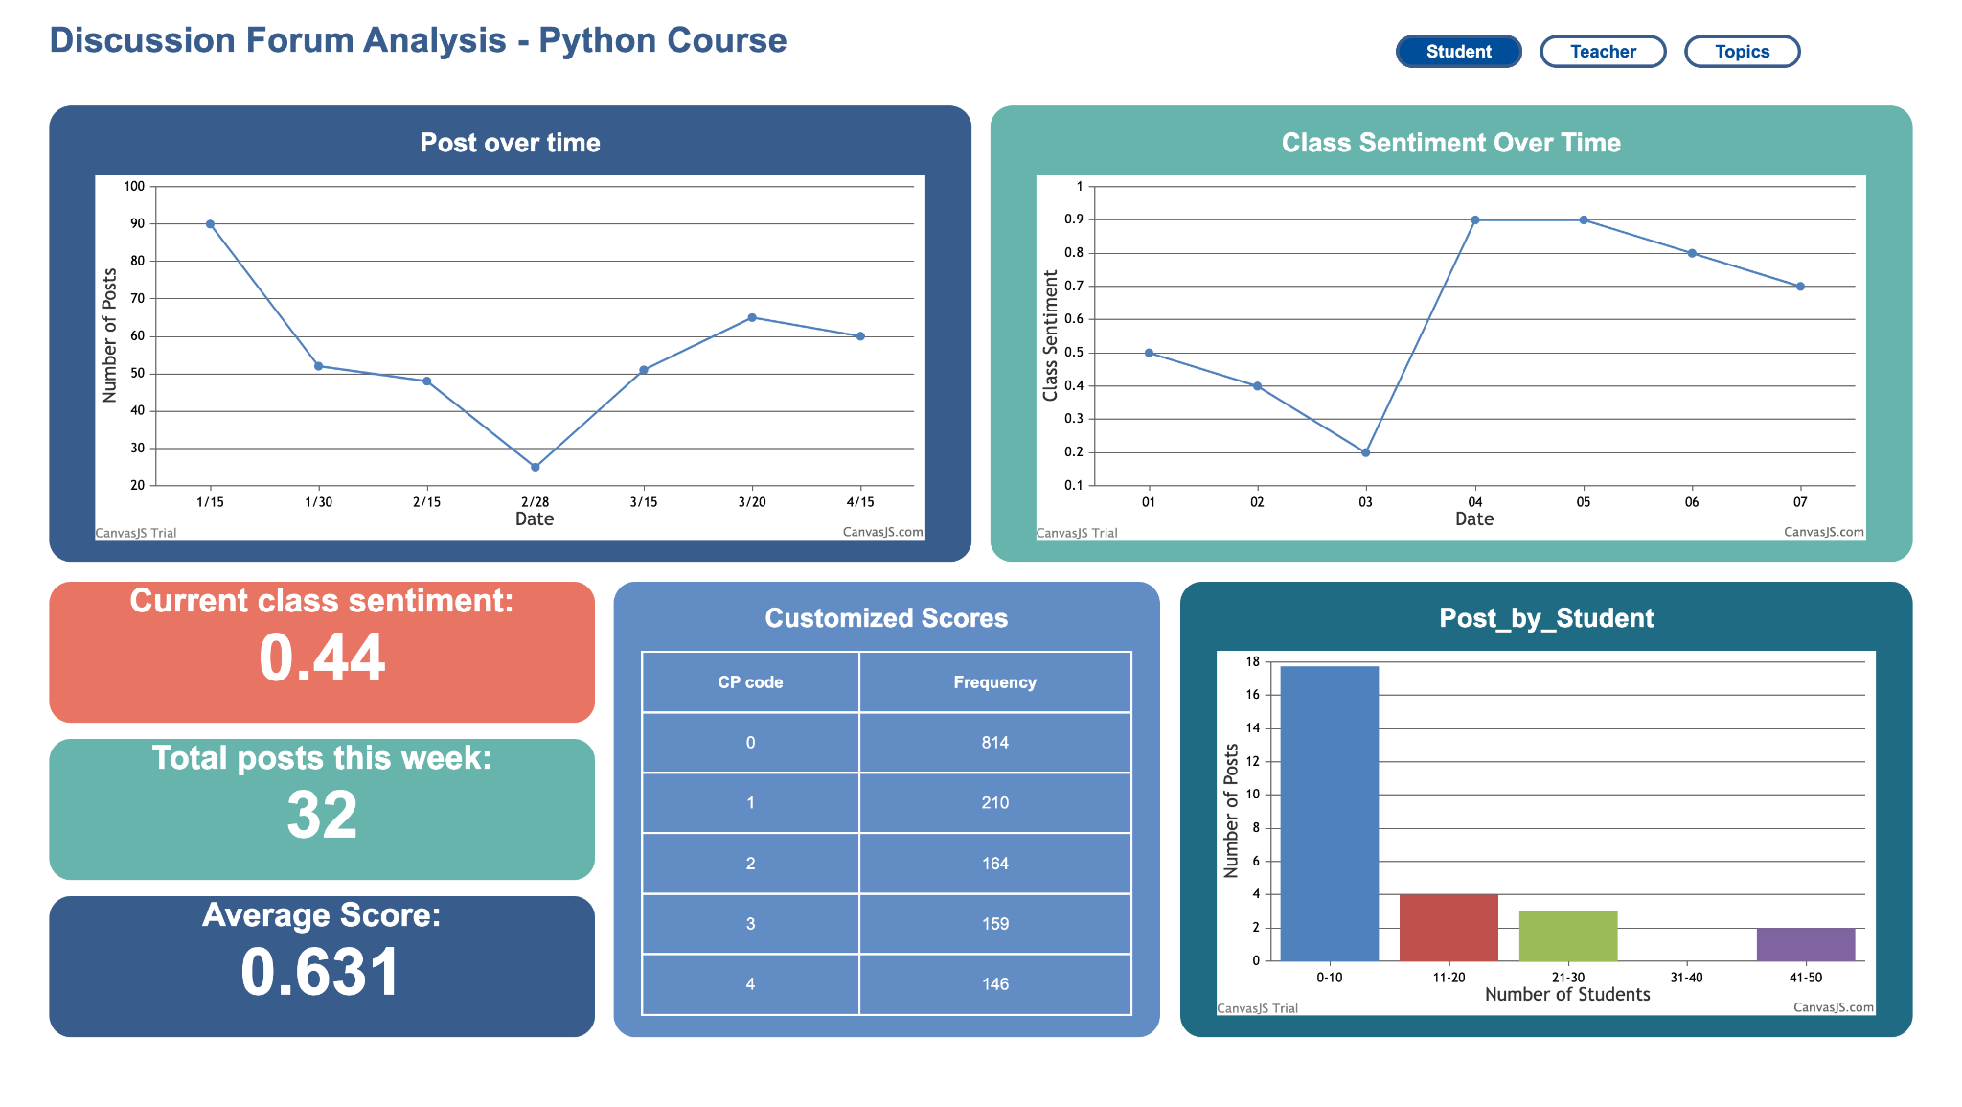
Notes:
Ankit

Slide 21
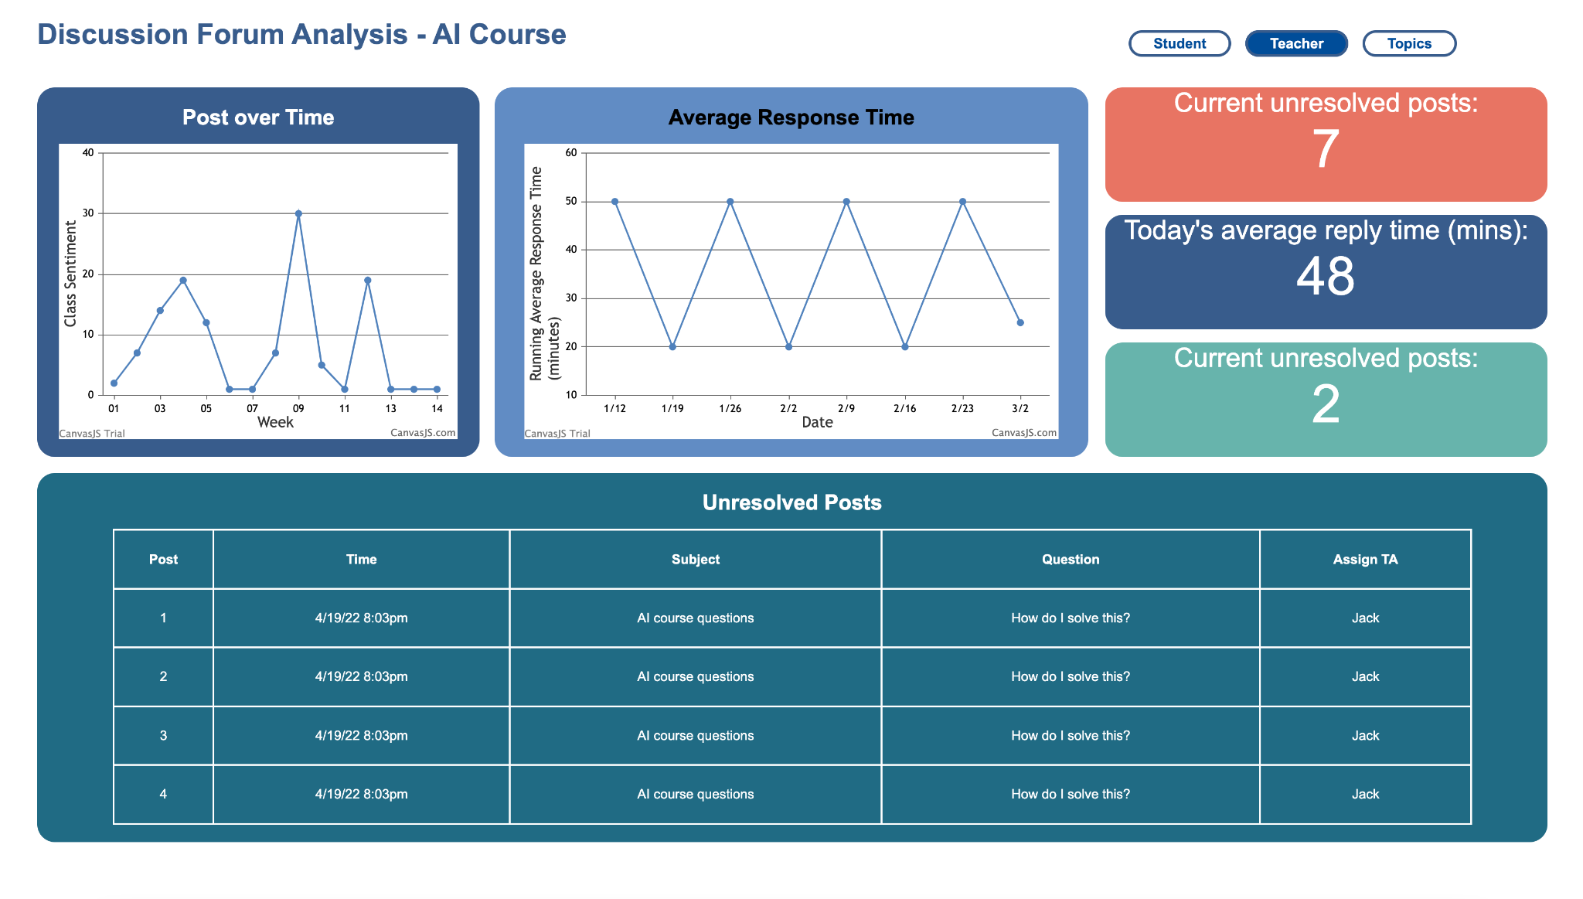
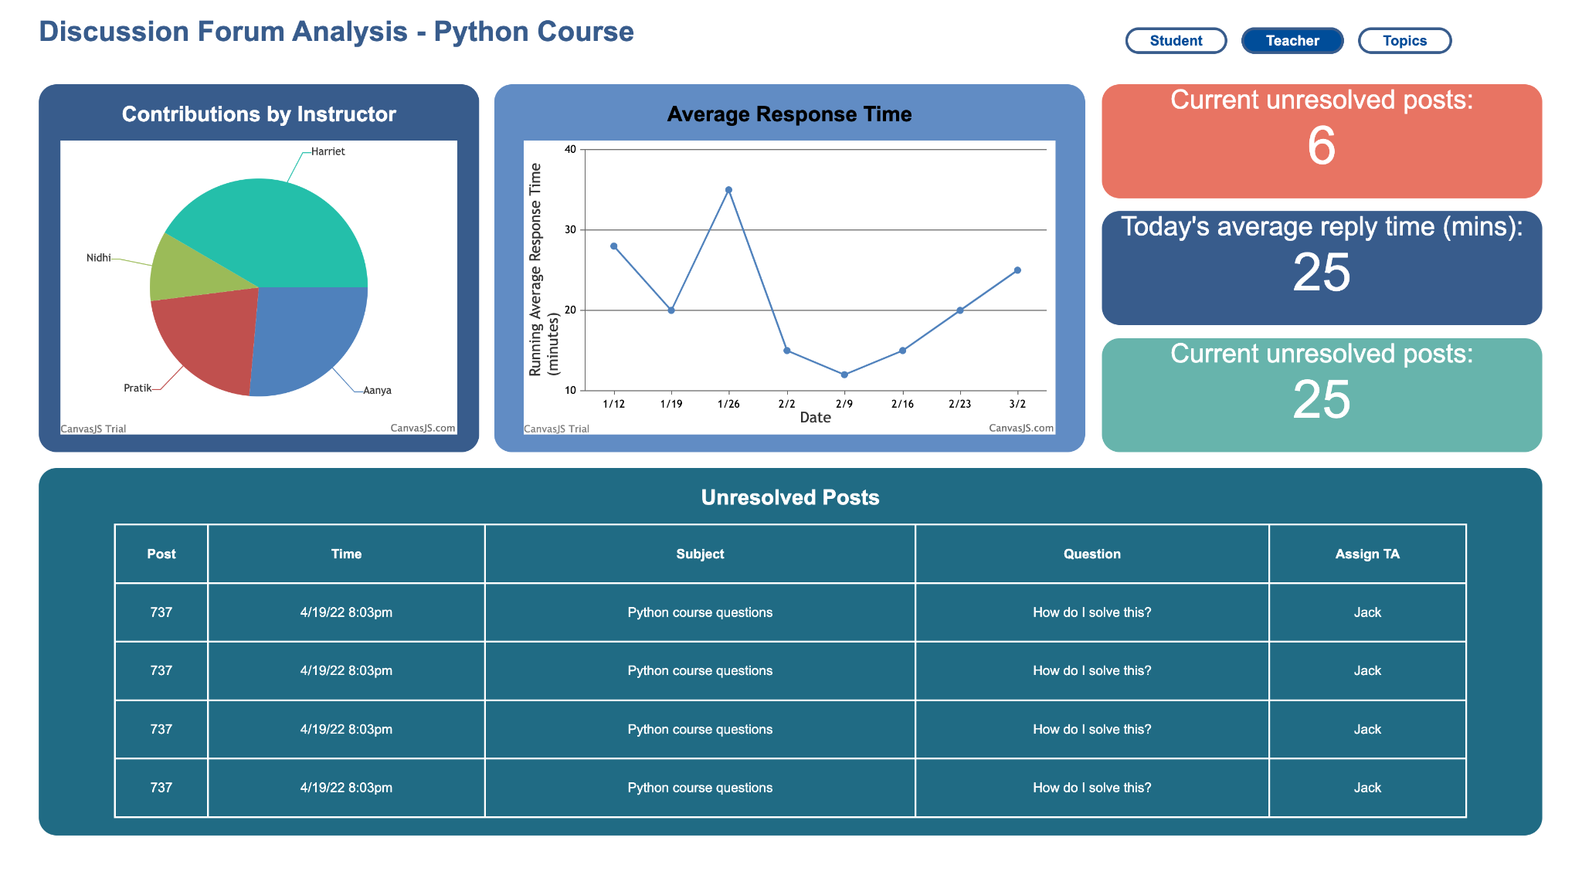
Notes:
Ankit

Slide 22
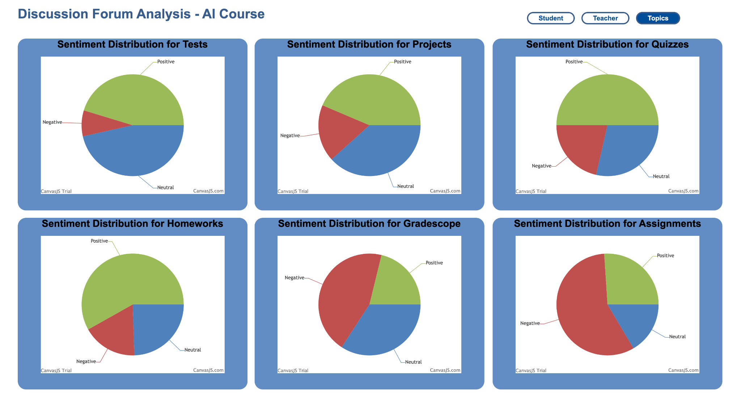
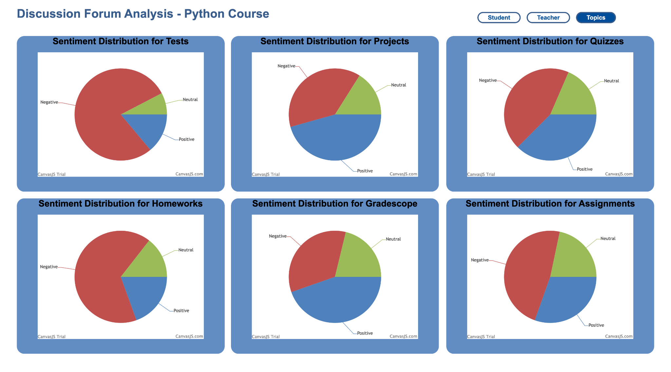
Notes:
Ankit

Slide 23
Ed Discussion API
GET
API
HTTP
REQUEST
Ed
Dashboard
HTTP
RESPONSE
JSON
Notes:
Youngwook Kang

Slide 24
Goals for this semester
Make the dashboard responsive so that it can be used on devices of all sizes.
Interview with TAs to find out the datas they find important and update the dashboard to show those information
  Student page: Add class sentiment graphs that complement posts over time
  Teacher page: Adds direct access to posts
Add an option to mark a post as scheduled
  Topic page: Add function to show reason for emotion
Get real-time data using the ed discussion API.
Notes:
Youngwook Kang

Slide 25
Conclusion
Accomplished
  Deployed all the data to our dashboards of two courses
Future Step
  Keep improving the accuracy of our models
  Integrate Topic Modeling and ABSA with increased accuracy
  Keep expanding user research to specific applications of dashboards
  Research on Ed discussion API and real-time API
Notes:
Jisan
To conclude, we have successfully deployed our analyzed data to our dashboards of two courses.
One of the next step is to improve the accuracy of our models. With that, integrating topic modeling and ABSA will give insights for the instructors. The other future step is to expand user research to specific applications of dashboards and research on ed discussion api and real-time api.
Thank you for your time.
Piazza data from ML class, edX data from CS1301

Slide 26
Citations
Peacock, S., & Cowan, J. (2016). From Presences to Linked Influences Within Communities of Inquiry. The International Review of Research in Open and Distributed Learning, 17(5). https://doi.org/10.19173/irrodl.v17i5.2602
Mishra, Ankit, Sugasi Guatam, & Gehani Ritika. (2022). Web Development Team Report. Georgia Tech Vertically Integrated Projects.
Mcdaniel, Rhett. “Metacognition.” Vanderbilt University, Vanderbilt University, 9 Feb. 1970, https://cft.vanderbilt.edu/guides-sub-pages/metacognition/.
“Topic Modeling: A Basic Introduction.” Journal of Digital Humanities, http://journalofdigitalhumanities.org/2-1/topic-modeling-a-basic-introduction-by-megan-r-brett/.
Castellanos-Reyes, D. 20 Years of the Community of Inquiry Framework. TechTrends 64, 557–560 (2020). https://doi.org/10.1007/s11528-020-00491-7
Notes:
Jisan

Slide 27
Questions?
Thanks for listening!
Notes:
Jisan

